Slide 1
Dynamic Modeling of Banking System Case Study - II
Lecture # 39

Slide 2
Dynamic Modeling
There are two ways to model dynamic behavior
One is the life history of one object as it interacts with the rest of the world; the other is the communication patterns of a set of connected objects as they interact to implement behavior

Slide 3
Dynamic Modeling
The view of an object in isolation is a state machine – a view of an object as it responds to events based on its current state, performs actions as part of its response, and transitions to a new state
This is displayed in state chart diagrams in UML

Slide 4
Dynamic Modeling
The view of a system of interacting objects is a collaboration, a context-dependent view of objects and their links to each other, together with the flow of messages between objects across data links
Collaboration and sequence diagrams are used for this view in UML. Both of these combined are called interactive diagrams

Slide 5
Dynamic Modeling
The dynamic model depicts the interaction among the objects that participate in each use case
The starting point for developing the dynamic model is the use case and the objects determined during object structuring

Slide 6
Today’s Topics
We’ll talk about the second view today
We’ll apply this to our Banking System application also
But, first let us review our knowledge about interaction diagrams as defined in the UML

Slide 7
Interaction Diagrams
Interaction diagrams are used to model the dynamic aspects a system. For the most part, this involves modeling concrete or prototypical instances of classes, interfaces, components, and nodes, along with messages that are dispatched among them, all in the context of a scenario that illustrates a behavior

Slide 8
Interaction Diagrams
Interaction diagrams may stand alone to visualize, specify, construct, and document the dynamics of a particular society of objects, or they may be used to model one particular flow of control of a use case

Slide 9
Types of Interaction Diagrams
Sequence diagrams
Collaboration diagrams

Slide 10
Sequence Diagrams
A sequence diagram is an interaction diagram that emphasizes the time ordering of messages
Graphically, a sequence diagram is a table that shows objects arranged along the X axis and messages, ordered in increasing time, along the Y axis

Slide 11
Collaboration Diagrams
A collaboration diagram is an interaction diagram that emphasizes the structural organization of the objects that send and receive messages
Graphically, a collaboration diagram is a collection of vertices and arcs

Slide 12
Hints and Tips on Interaction Diagrams
Give it a name that communicates its purpose
Use a sequence diagram if you want to emphasize the time ordering of messages
Use a collaboration diagram if you want to emphasize the organization of the objects involved in the interaction

Slide 13
Hints and Tips on Interaction Diagrams
Lay out its elements to minimize lines that cross
Use notes and color as visual cues to draw attention to important features of your diagram

Slide 14
Collaboration Diagram: ATM Client Validate PIN Use Case
:BankServer
1: Card
Reader
Input
1.2: Card
Inserted
:CardReader
:CardReader
Interface
2.5: Validate PIN
(Customer Info)
2.6: [Valid]
Valid PIN
1.1: Card
Input Data
:ATM
Control
2.4: PIN Entered
(Customer Info)
:ATMCard
1.3: Get
PIN
2.7a: Update
Status
2.2: Card
Data
2.1: Card
Request
2.7: Display
Menu
1.4: PIN Prompt
2.8: Selection Menu
:Customer
Interface
:ATM
Transaction
2: PIN Input
2.3: Customer Info

Slide 15
Sequence Diagram: ATM Client Validate PIN Use Case - 1
:CardReader
Interface
:ATMCard
:ATMControl
:Customer
Interface
:ATM
Transaction
:BankServer
:ATM
Customer
1: Card
Reader Input
1.1: Card Input Data
1.2: Card Inserted
1.3: Get PIN
1.4: PIN Prompt

Slide 16
Sequence Diagram: ATM Client Validate PIN Use Case - 2
:CardReader
Interface
:ATMCard
:ATMControl
:Customer
Interface
:ATM
Transaction
:BankServer
:ATM
Customer
2: PIN Input
2.1: Card Request
2.2: Card Data
2.3: Customer Info
2.4: PIN Entered
2.5: Validate PIN
2.6: [Valid]: Valid PIN

Slide 17
Sequence Diagram: ATM Client Validate PIN Use Case - 3
:CardReader
Interface
:ATMCard
:ATMControl
:Customer
Interface
:ATM
Transaction
:BankServer
:ATM
Customer
2.7: Display Menu
2.7a: Update Status
2.8: Selection Menu

Slide 18
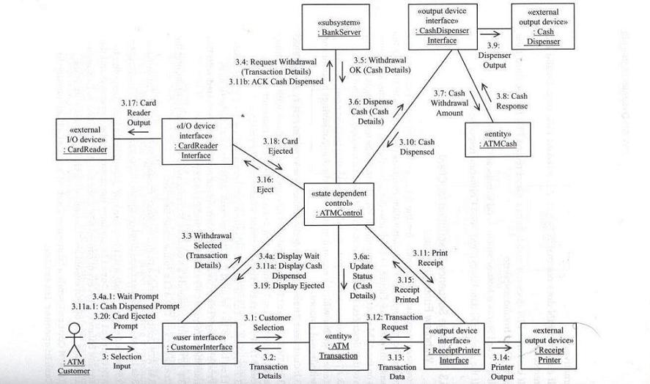
Collaboration Diagram: ATM Client Withdraw Funds Use Case

Slide 19
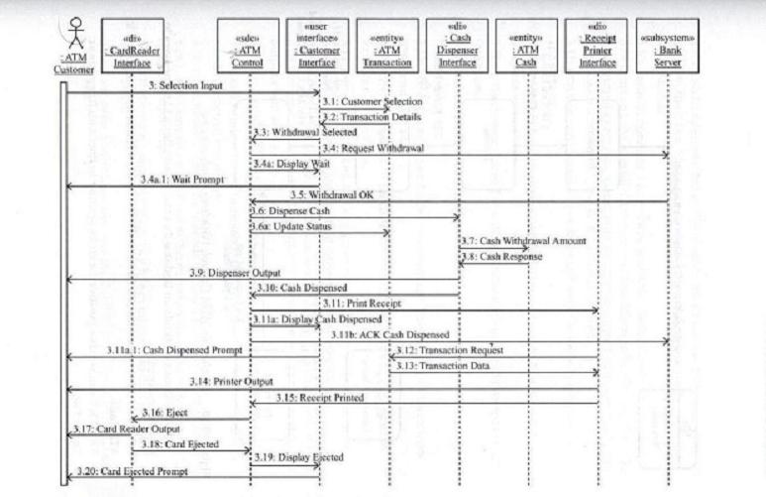
Sequence Diagram: ATM Client Withdraw Funds Use Case

Slide 20
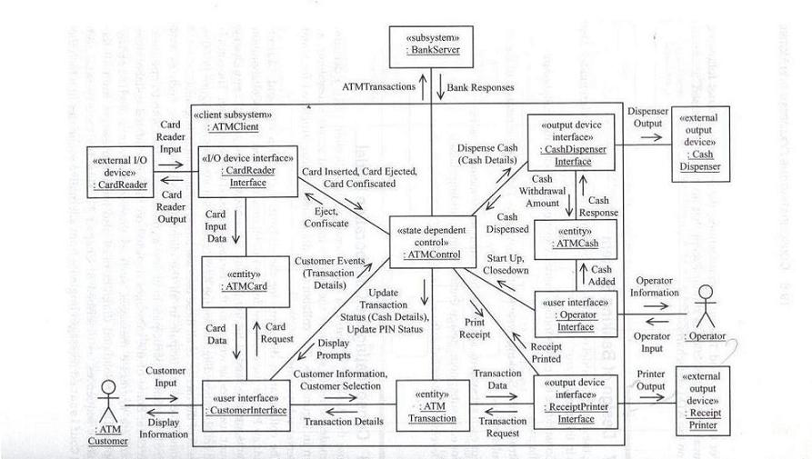
Consolidated Collaboration Diagram for ATM Client Subsystem

Slide 21
Summary
In the last lecture we introduced the dynamic modeling through statecharts
In this lecture we have gone through the other aspect of dynamic modeling, i.e. Interaction diagrams
We can model the interaction of objects through Sequence diagrams and Collaboration diagrams

Slide 22
References
‘Designing Concurrent, Distributed, and Real-Time Applications with UML’ by H. Gomaa, Addison-Wesley, 2000
‘The Unified Modeling Language User Guide’ by G. Booch, J. Rambaugh, & I. Jacobson, Addison-Wesley, 1998
‘The Unified Modeling Language Reference Guide’ by J. Rambaugh, I. Jacobson, & G. Booch, Addison-Wesley, 1998

